Slide 1
Chapter 1 Problems

Slide 2
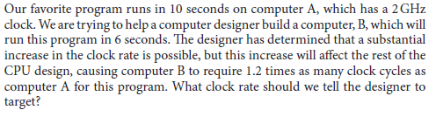
Problem1

Slide 3
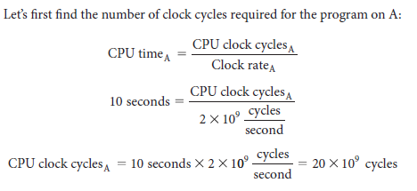
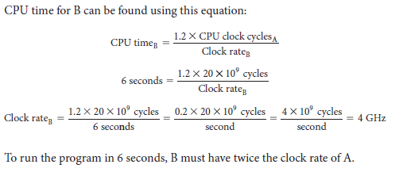
Solution

Slide 4
Problem2
Suppose we have two implementations of the same instruction set architecture.
Computer A has a clock cycle time of 250 ps and a CPI of 2.0 for some program, and computer B has a clock cycle time of 500 ps and a CPI of 1.2 for the same program.
Which computer is faster for this program and by how much?

Slide 5
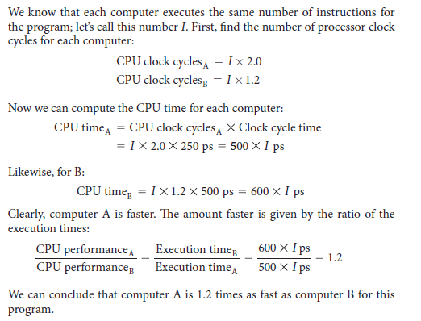
Solution

Slide 6

Problem 3
Suppose a program runs in 100 seconds on a computer, with multiply operations responsible for 80 seconds of this time. How much do I have to improve the speed of multiplication if I want my program to run five times faster?
Note: The execution time of the program after making the improvement is given by the following simple equation known as Amdahl’s Law:

Slide 7

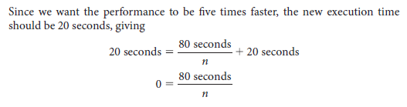
Solution

Slide 8
Problem 4
Consider three diff erent processors P1, P2, and P3 executing the same instruction set. P1 has a 3 GHz clock rate and a CPI of 1.5. P2 has a 2.5 GHz clock rate and a CPI of 1.0. P3 has a 4.0 GHz clock rate and has a CPI of 2.2.
Which processor has the highest performance expressed in instructions per second?
If the processors each execute a program in 10 seconds, fi nd the number of cycles and the number of instructions.
We are trying to reduce the execution time by 30% but this leads to an increase of 20% in the CPI. What clock rate should we have to get this time reduction?

